Slide 1
Quarterly AAF and Submitting Reports

Slide 2
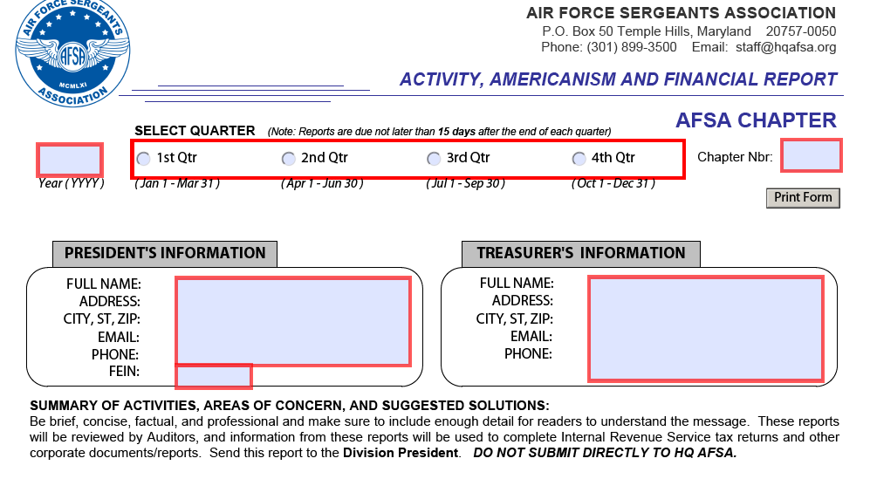
Beginning your AAF
Notes:
The top section of the AAF is self explanatory. Make sure the addresses listed for the President and the Treasurer match what you sent in on your DOO.

Slide 3
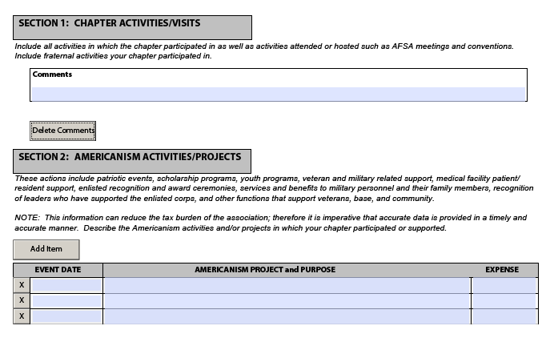
Section 1 and 2
Notes:
Section 1: Chapter Activities/Visits – show chapter meeting dates, location and number of attendees. Show topics discussed and any voting results. Also show other meetings or activities and visits where the chapter was represented or participated in and list the action taken and results. For example: Month of the military child events, fun events, events with out base organizations (this will be important later)
Section 2: Americanism Activities/Projects – show chapter financially hosting/sponsorship of social events. Also show all chapter donations/contributions of funds to base units/other organizations. Where no chapter funds were involved, place number of hours in the project purpose line and put a zero in the expense column. Expenses
shown in this section must also be reported in Section 8 as Contributions.

Slide 4
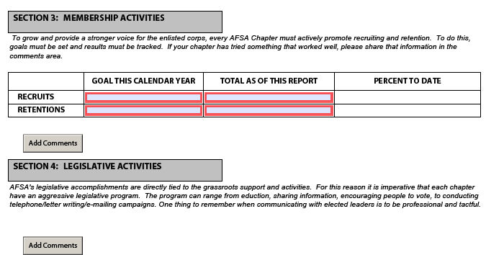
Section 3 and 4
Notes:
Section 3: Membership Activities – once you have entered the goals, check the AFSA website at the end of each quarter to obtain the chapter’s recruits and retentions and enter them. Only report the totals through the end of the quarter being reported. **this is a good time to compare what you know to what is being reported, contact HQ if you see any discrepancies.
Section 4: Legislative Activities -- show when items sent to you by AFSA HQ/Division 2 are forwarded to the chapter members/discussed during chapter meetings. Show any legislative events you did (briefins, LAW weeks, etc). Also show if members contacted their elected officials and the results (if known).

Slide 5
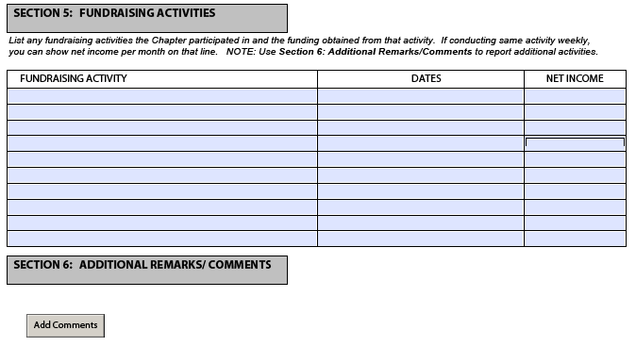
Section 5 and 6
Notes:
Section 5: Fundraising Activities – show all events to raise funds for the chapter – list the event, dates it ran, and the net income (total income minus expenses). Events shown here must also be reported in Section 7.
Section 6: Additional Remarks/Comments – use this block for items not covered elsewhere (i.e., explain income being reported in Section 7 as Miscellaneous and/or Other; or explain an error made in Sections 7 or 8 of a previous report and being corrected in the current report; etc.).

Slide 6
Summary of Sections 1-6
Some items/events will be repeated
Money earned is money received or money you should receive based on the event
For example: your chapter did a virtual 5K that raised $XXX amount but the check is in the mail when you write the report. You will count this.
If you do not know the amount being sent to you, do not estimate or round up

Slide 7
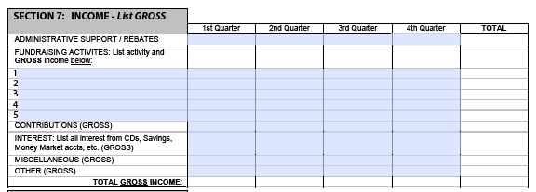
Section 7
Notes:
Section 7: Income-List Gross –
Administrative Support/Rebate -- list the amount you received from AFSA HQ for previous quarter’s administrative support payment and recruiting & retention rebates.
Fundraising Activities -- list each event being accomplished and the Gross Amount received on a separate line. You only have five lines so title the events to fit the space; i.e., if you work at an arena/stadium that have different shows/events, instead of listing each show or event, title it Support XXX Arena/Stadium. (Individual events should be reported in Section 5.)
Contributions – list total donations received by the chapter during the quarter.
Interest – list all interests and dividends received during the quarter.
Miscellaneous – list income received from other sources here; however, it should be explained in Section 6.
Other – you may list membership dues collected here. Whatever the source of the income, it should be explained in Section 6.
NOTE: Only include income physically received during the quarter – do not include expected income that has not been received

Slide 8
Section 8
Notes:
Section 8: Expenses –
Awards – enter the amount spent in honoring Chapter members and others for outstanding service to the Chapter. Do you sponsor ALS awards?
Contributions – enter total donations the Chapter made in financial funds to unit organizations and other organizations. (Individual donations should be listed in Section 2.)
Conventions/Meetings – enter total amount the chapter spent to send representatives to the Division and AFSA International conventions and any area meetings attended where a fee was required.
Fundraising Activities – enter expenses spent in support of raising funds for the chapter.
Office Expense – enter amount spent on general office supplies (i.e., paper, envelopes, stamps, etc.).
Social Functions –enter amount expended on social functions (i.e., picnics, meeting lunches, etc.). (This should also be shown in Section 2.)
List any other Category on the five blank lines and enter the amount expended for each for each quarter. Some chapter make the additional lines match their budget lines; this allows them to track what was budgeted versus spent in one location.
Due to the limited space, do not list individual events.

Slide 9
Section 9
Notes:
Section 9: Fund Balance – Beginning Fund Balance -- at the beginning of each year, enter the Ending Fund Balance from the previous year’s 4th quarter report. The form will automatically recalculate the Ending Fund Balance for each quarter as figures are entered. For each period being reported ensure the Fund & Bank must balance to “0” block at the far right is $0.00. ***This is the number one mistake on most first quarter reports***

Slide 10
Notes for Sections 7, 8, and 9
You may not change/delete/omit any financial figures reported in these sections on previous reports.
This is a running record of the Chapter’s financials for the year.
Starting with the second quarter report through the fourth quarter report, use the previous quarter report.
This will not always match what is in your checking account.

Slide 11
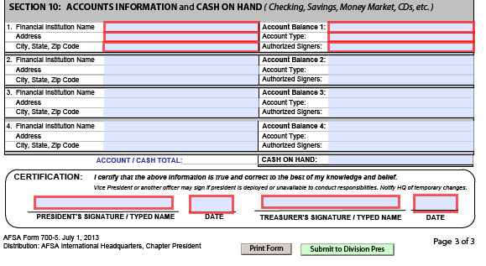
Section 10
Notes:
Section 10: Accounts Information and Cash on Hand – list financial institutions that you have accounts with (i.e., checking account, saving account, certificate of deposits, investment accounts, etc.). If you have more accounts than the space allow, in block 4 enter “See Attached Sheet” and enter the total of the amount from the attached sheet in the Amount Balance 4 block. On a separate sheet of paper and enter each account in the same format as shown on the original form.
NOTE: The balance in each account should be the bank balance at the end of the month of the quarter being reported on minus any outstanding checks. Deposits to accounts are based on the actual date of deposit, not when funds are received. AFSA does not conduct financial operations using cash, all income and expenses are to go through the chapter bank account(s) to ensure proper record keeping. This number does not have to match your Section 9 number.
Certification block – enter the President’s/Vice President’s and Treasurer’s name and the current date the report was prepared and submitted. **you can sign in PDF or wet sign**
***DO NOT use the submit to Div Pres button. See next slides for info on where to send the report.

Slide 12
AFSA File names and Due dates
ANNUAL BUDGET: File Name F0499 CY20XX Annual Budget
Due by 15 January each year for the current year.
ANNUAL AUDIT: File name: F0499 CY20XX Annual Audit
for the previous year
due by 15 February of the current year.
DOO (Directory of Officers):
Post Election DOO, due by 15 Feb: File Name F0499 C20XX DOO FEB 20XX
Due within 15 days of updates to any (or all) officers after initial DOO: F0499 CY20XX DOO FEB XXXX F0499 CY20XX DOO (U) AUG
***NOTE: An updated DOO is treated as a completely new DOO and replaces your previous DOO***
Group Filing Authorization Form/ Form 990: File Name F0499 CY20XX Group Filing
due by 15 November of the current year.
****Chapter numbering should be F then your chapter number in four-digit format. For example, F0358, F0404, F0554****
*****CY20XX- means the last two digits should be the calendar year, CY2021*****
Notes:
Any X’s are the year

Slide 13
AFSA File names and Due dates
AAF Report (Americanism, Activity and Financial Report): a quarterly report due by the 30th of the month following the end of the quarter. A separate email will talk more about this report.
F0499 CY20XX-4th Qtr AAF Rpt (Due 15 Jan of following Calendar year)
F0499 CY20XX-1st Qtr AAF Rpt (Due by 30 April)
F0499 CY20XX-2nd Qtr AAF Rpt (Due by 30 July)
F0499 CY20XX-3rd Qtr AAF Rpt (Due by 30 October)
***NOTE: While the AAF Report states that the report is due by the 15th of the month, AFSAM 100-2 specifies the due date to be 30 days after the end of the quarter. This difference is because you have to send your AAF to your Division Coordinator, they send it to the Div 2 President and then it gets to HQs AFSA. If you submit to your regional lead after the 15th your report may not make it to HQs in time
****Chapter numbering should be F then your chapter number in four-digit format. For example, F0358, F0404, F0554****
*****CY20XX- means the last two digits should be the calendar year, CY2021*****

Slide 14
Penalties for Late Reports
Chapter of the Year
Any Chapter that is late for an AAF loses 5 points per quarter they are late and are INELIGIBLE for the annual award if any report is missing on 31 December
Quarterly Payments
Your chapter will not receive its quarterly Administrative Support/Rebate if your report is not received by the 30th of the month following the quarter.
After a certain number of missing reports, HQs and/or the Division can decide to disband your chapter and disperse your members to the nearest chapter to them
There is no specific number of reports, but 3 missing reports is when the conversation starts at the Division level.

Slide 15
Submitting Any Report
Send reports to:
3XX chapters, submit to Rich Mansfield, email: richmansfield55@gmail.com
4XX chapters, submit to Murphy Green, email: mlgretired@aol.com
5XX chapters, submit to Michael Shelley, email: AFSADiv2RD5XX@gmail.com
Only one report per email
Subject line should be report file name
***No mail.mil or us.af.mil submissions***
Notes:
CHAPTERS DO NOT SEND REPORTS DIRECTLY TO AFSA HQ, BUT TO THEIR REGIONAL DIRECTOR

