Slide 1
HQ AFSA And Div 2 Websites
Division 2

Slide 2
Navigating the HQ’s AFSA Website https://members.hqafsa.org/

Slide 4
Chapter Look up
Notes:
Zipcode/Chapter Look up:
This will show what chapter is closest to any Zipcode. This is useful for the members that have left the area or are PCSing.
Chapter Leadership Lookup:
This will show anyone the President and Vice President info for every chapter worldwide

Slide 6
Member Search
Notes:
Member Search:
Useful to verify membership status prior to voting
Useful to show paid through date, current chapter and Member ID.
**Search any member with the minimum of first letter of Last Name.

Slide 7
Notes:
Shows AFSA HQ President Visits and conversations and the latest news from the International President.

Slide 8
Notes:
Shows AFSA HQ President Visits and conversations and the latest news from the International President.

Slide 9
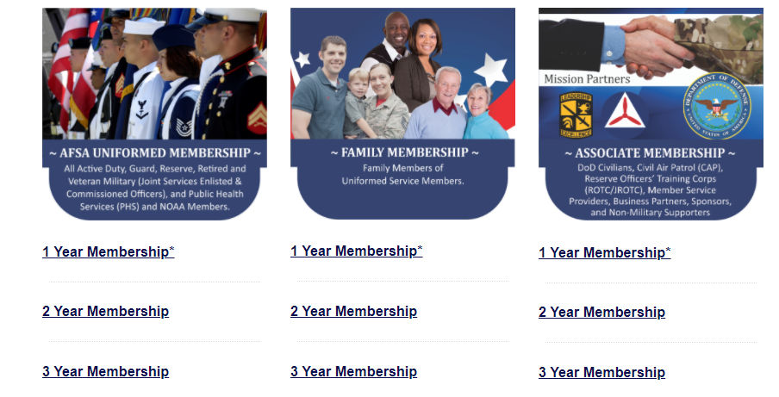
Membership Campaign Information
AFSA Family Matters
Notes:
Has links to any active campaigns, recruiter handbooks, tips and tricks for membership drives. Under the AFSA Family matters link you can find pricing and info on all membership types.

Slide 10
Notes:
Shows AFSA HQ President Visits and conversations and the latest news from the International President.

Slide 11
Reports
Notes:
As a chapter President you will not have every report listed on this page. The ones that you need to be familiar with are listed below:
Retain for all Members: This roster shows the current retain stats for EVERY AFSA member worldwide.
Recruit & Retain by Chapter (PDF and Excel): This roster shows the recruit and retain number for you chapter (good to know for annual awards packages)
Recruit & Retain (PDF and Excel) Your data: This roster shows the recruit and retain number for all members assigned to your chapter. This is only as accurate as the info your recruiters and retainers put on the forms. If there is not a member ID from a chapter member listed on the form sent to HQs, your chapter will not get credit.
Chapter Presidents: This will show all sitting Chapter presidents and their contact info (as listed on DOOs)
Division Presidents: This will show all division Presidents and their contact info (as listed on DOOs)
International Officers: This will show HQ AFSA leadership and contact info
4 Month Chapter Roster (PDF and Excel): This roster will show you who is expiring in 4 months. For example, if you want to know who is expiring in May, Run the report in January. Recommendation: have your membership lead run this report each month and send a personalized message to the person with AFSA/Chapter Events and successes and remind them on their importance to AFSA as well as ways to renew their membership.
Bad Address Listing: This roster shows everyone in your chapter that has a bad address according to the USPS. This could mean they have rejected mail as return to sender OR they have moved but their mail forwarding has expired. If a member is listed on this roster you are not being paid for them in your quarterly payment. It is helpful to contact these members and update their address with HQs even if the address listed is correct.
Chapter Roster: This is every member assigned to your roster. It will show all contact info, membership status, if they have a bad mailing address, etc. You can use this roster to create your email contact list if you save it in the format your email service requires and upload it. Gmail wants you save it as “.csv” file.
Gain Loss Transfer Roster: This roster can show you who has left your chapter and who has moved to your chapter. You can use this to send monthly “welcome” emails where you share meeting info and Chapter upcoming events. It also saves you time in updating your email contact list.
Of note, keep copies of the reports you run and compare them. If you find errors in any of the reports, contact HQ AFSA to have them correct it. Your quarterly payments are only as accurate as the data HQs has.

Slide 12
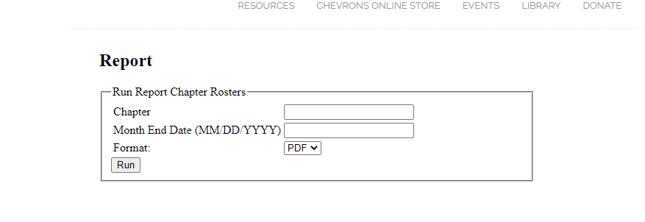
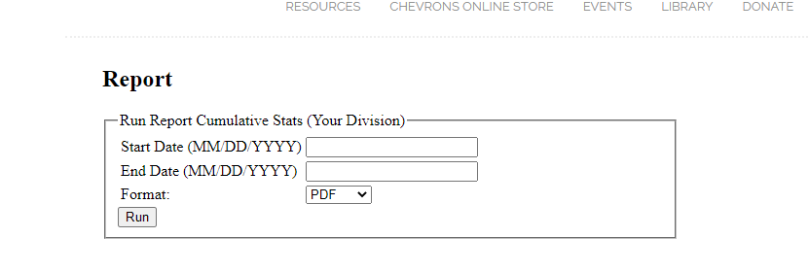
Reports
Notes:
Start date should always be the 1st of the month and end dates are the last day of the month. For example, if I want to run a chapter report for the month of February, I will run it from 1 Jan 2021 to 28 Feb 2021. This allows for any expiring in that timeframe to be shown as well as catch any updates that happened from the last time I ran it.
Some rosters ask if you want PDF or excel, while some say the title or the title (linear). Linear is excel, if not listed you will either have to choose or it will be PDF.

Slide 13
Notes:
Shows AFSA HQ President Visits and conversations and the latest news from the International President.

Slide 14
Chapter EPA
Chapter Continuity book
Professional Organization Development Templates
National Military Association Paperwork for Wing Routing
Ideas for Base events
POW/MIA
JROTC participation
CLEP/DANTE Presentations
Fun Runs
Bowling
Mock Boards
Airmans Attic
Membership/Recruiting Parties
Notes:
This site houses extensive documents on ideas and info for base interaction.

Slide 15
Notes:
Shows AFSA HQ President Visits and conversations and the latest news from the International President.

Slide 16
Resources
Notes:
This is one of the tabs you will spend most of your time on during your council tenure. AFSA Manuals, forms, logos, and tool kits are located here. Information on each divisions campaign is updated as HQs AFSA gets it.

Slide 18
Chevrons Online Store
Notes:
Quick resource to order an Official HQ AFSA Forms, logos, Certificate holders, or any AFSA logo gear (umbrellas, flags, flashlights, etc)

Slide 19
Notes:
The events tab is where you will see any data on the Professional Airman’s Conference. The 2021 information is still pending update.

Slide 21
AFSA Library
Notes:
The AFSA Training and Development videos Tab houses 4 videos from the 2020 Virtual PAC. AFSA updates from President Carton, What is AFSA by Mr. Keith Reed, the 2020 NDAA overview from Matthew Schwartzman, and the 2019 HQ AFSA Awards Ceremony.
The professional Development Videos Tab host 12 videos from the 2020 Virtual PAC. These videos range from The CMSAF Panel, CSAF General Brown and CMSAF Chief Bass, to Financial Readiness with USAA

Slide 23
Donate Tab
Notes:
The final tab, Donate, shows the 4 charities that HQ AFSA used to “take care of their own” through AFSA International Charities Programs.

Slide 24
Navigating the Division II Website http://www.afsadiv2.org/

Slide 25
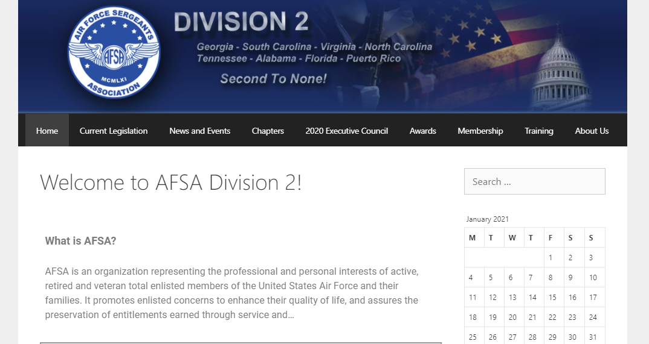
Notes:
The home page will show you any upcoming events. We encourage you to send us your events and we will place them on the calendar for other chapters to support you!

Slide 26
Notes:
The Current Legislation is still under construction, but this is where you will see breakdowns and data on L.A.W (Legislative Awareness Week)

Slide 27
Notes:
The Chapters tab will give you the location and links to Websites/Social media accounts for all Division 2 Chapters.

Slide 28
Notes:
This tab gives you the names, contact info and roles for everyone on the Division 2 council.

Slide 29
Notes:
This tab shows the previous years award winners by Category AND shows you sample packages from previous winners.

Slide 30
Notes:
This tab houses membership information from HQs as well as DIV 2 specific data. There is a letter that can be shared with your Cyber members that are expiring, Top Recruiter/Retainer info, benefits, and discount cards. All information that can be useful during membership drives.

Slide 31
Notes:
The Training tab is where you can go for Division 2 training information. This tab is still under construction, so let us know what you want featured or built.

Slide 32
Questions??

